Slide 1
Bill Pay Application

Slide 2
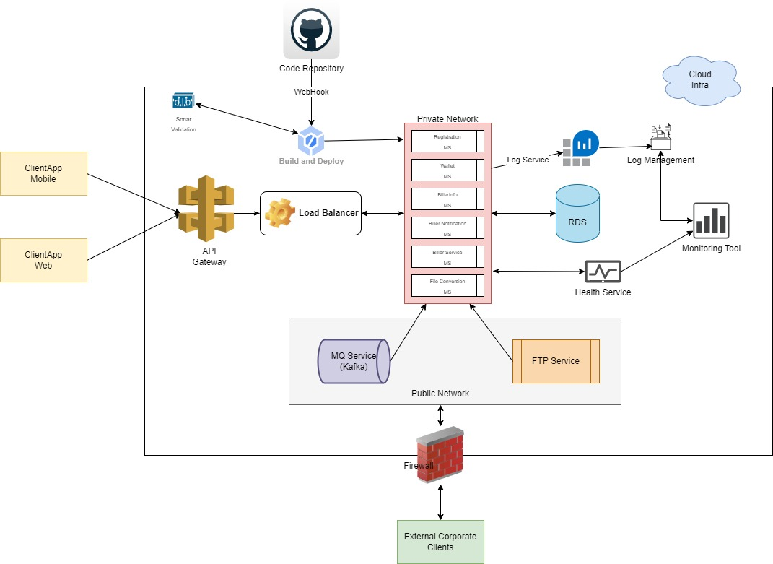
Architecture Diagram
Tech Stack:
Java, SpringBoot
ReactJS - UI
Mobile App
Jenkins
API Gateway
Oracle (RDS)
Load Balancer
ECS
AppDynamics / Kibana / Grafana
FTP
Kafka
GitHub
Sonar Cube

Slide 3
Microservice Details
Wallet Service : Wallet service will responsible for maintaining wallet related transactions.
Registration Service : Registration service will handle registration process of Users
BillerInfo Service : BillerInfo service will maintain billing information of application users from different Biller clients.
MQ Payment Service : MQ service will run on Kafka service which will take care of events on for payments to 3rd party service and receive acknowledge of payments.
FTP Service : Physical FTP location to receive files from corporate clients.
FTP Polling Service : Polling service will poll data from FTP to process further file processing.
MQ File Service : MQ File service will run on Kafka service to receive files over defined queue from corporate clients.
Propriety File Conversion Service : File conversion service will convert all type of files to propriety file format to avoid changes in downstream systems to handle multiple files format.
Biller Notification Service : Notification service will push notification to client Application.

Slide 4
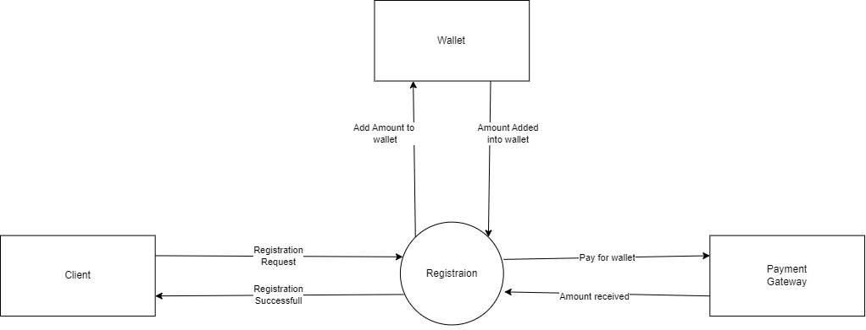
Registration Context Diagram

Slide 5
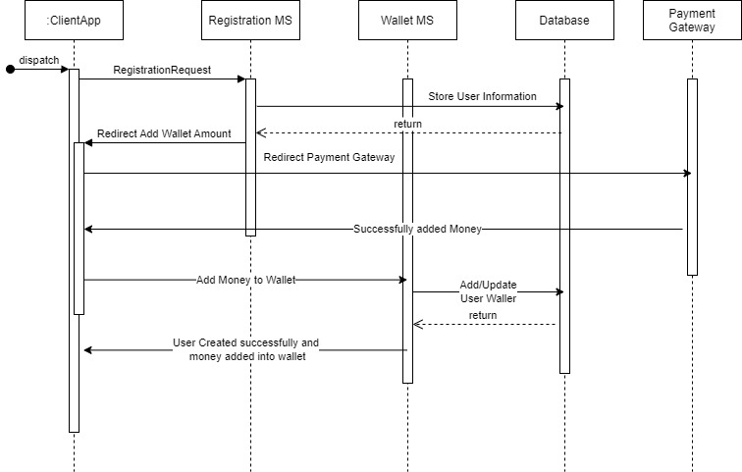
Registration Sequence Diagram

Slide 6
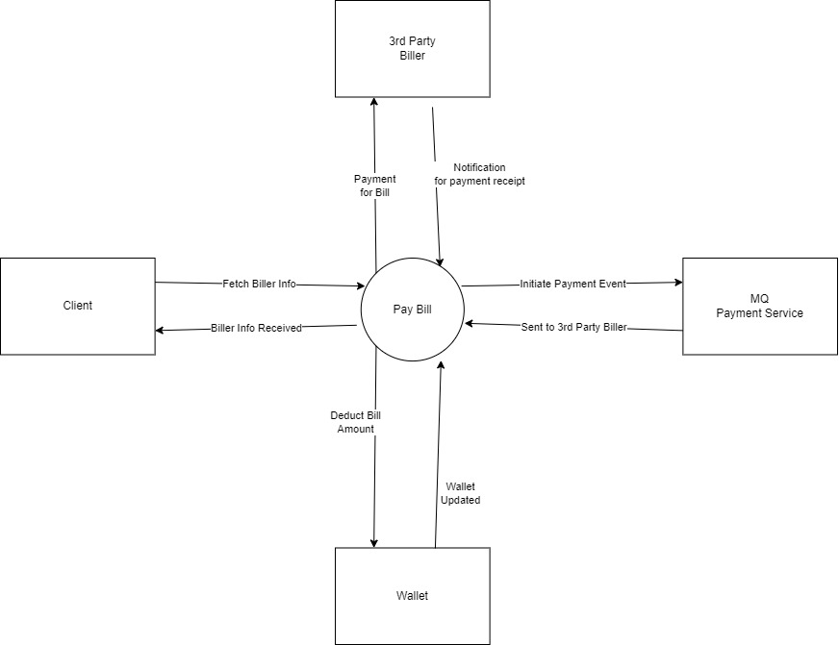
Pay Biller Context Diagram

Slide 7
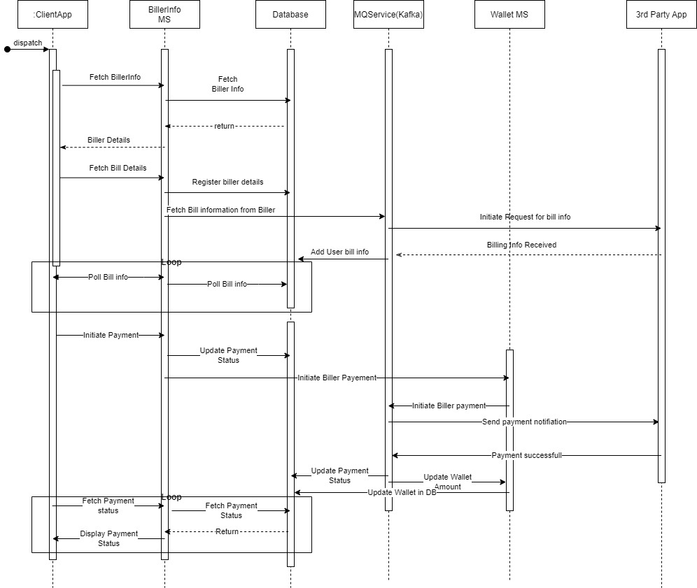
Pay Biller Sequence Diagram

Slide 8
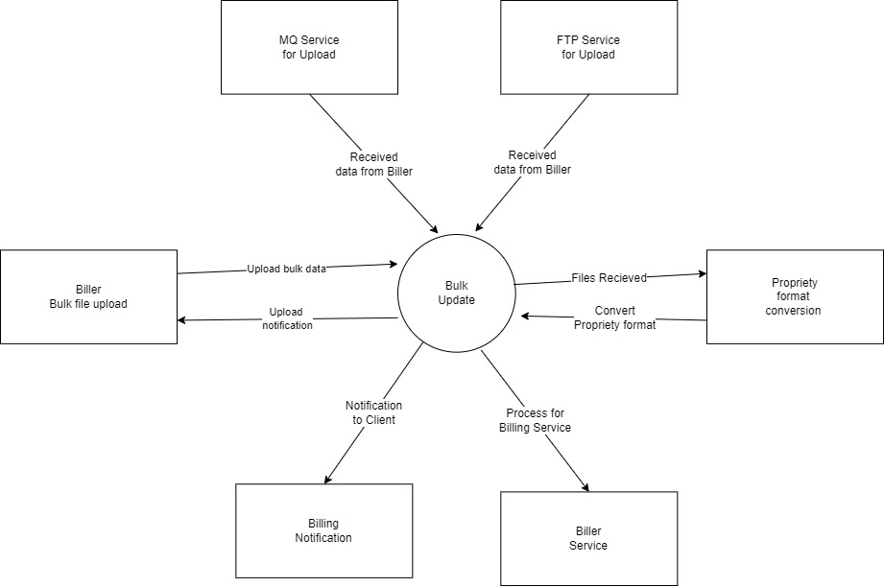
Bulk Upload Biller Data Context Diagram

Slide 9
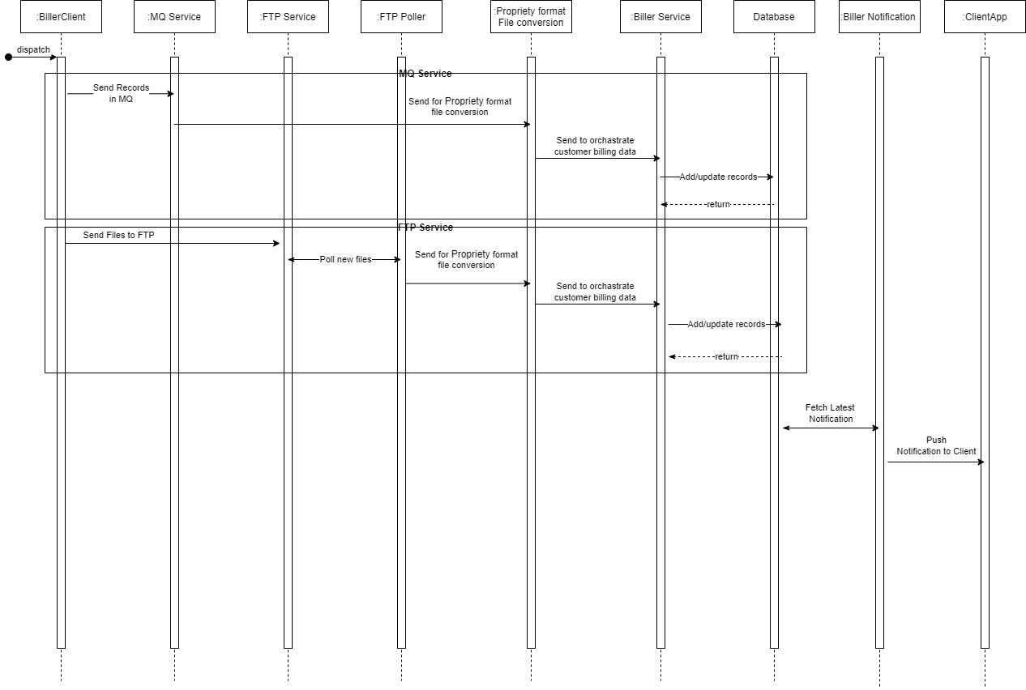
Bulk Upload Biller Data Sequence Diagram

Slide 10
Thank You

